Slide 1

Adaptive Cognitive-Load Study Timer for Personalized Break Scheduling
Revolutionizing student productivity with a privacy-first, adaptive learning tool.
The Problem
Our Approach
Students rely on fixed timers, ignoring natural cognitive load fluctuations. This leads to premature interruptions or prolonged exhaustion, reducing study efficiency.
A privacy-first app fusing typing/touch dynamics + micro-EMA. Features an Adaptive Scheduler, Chronotype Heatmap, and Intent-Lock for personalized focus.
Estimator
Inputs typing and touch dynamics
Scheduler
Outputs adaptive work and break intervals
Student
Central adaptive agent receiving and sending data
Heatmap
Visualizes daily rhythm and peaks
Intent-Lock
Controls distractions to protect focus
Our system addresses critical gaps in existing static study tools, supporting millions of students.

Slide 2
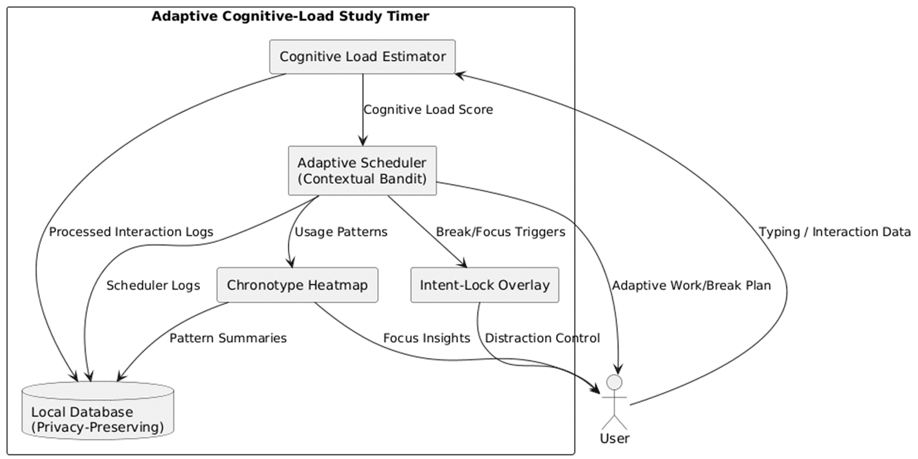
High level Architecture diagram
Our system addresses critical gaps in existing static study tools, supporting millions of students.
Notes:
The cognitive load estimator provides a score.
The contextual bandit takes that score plus context like typing rhythm and time of day.
It chooses the next work interval and break length.
The outcome is evaluated as a reward based on how much fatigue was relieved and how much progress was made.
Over time, it learns each student’s unique rhythm.

Slide 3

Bogahawatta B.P.S. -- IT22148254
B.Sc. (Hons) Degree in Information Technology Specializing in software engineering
IT22148254 | BOGAGAWATTA B P S | 25-26J-458

Slide 4



Cognitive load estimator : Proven Gap & Creative Solution: Enhancing Cognitive Load Measurement
Our research addresses critical limitations in existing methods for assessing cognitive load, proposing a novel approach that balances accuracy with user privacy and practicality.
Knowledge Gap & Problem Definition
Our Creative Solution
Addressing Existing Shortcomings
Existing tools either lack adaptability (commercial timers) or demand intrusive monitoring (lab-based methods). Our solution resolves this dilemma by developing a novel, non-intrusive sensing subsystem that fuses two distinct data streams.
Intrusive Measurement Techniques
Academic research often relies on intrusive sensors like EEGs or cameras for cognitive load detection. These methods are impractical for daily use and raise significant privacy concerns. Traditional survey methods, such as NASA-TLX, are too burdensome for real-time assessment in dynamic environments.
Passive Sensing
We continuously and unobtrusively analyze privacy-preserving computer interaction data. This includes keystroke timing, pause bursts, and error rates. Crucially, only timing metadata is used, ensuring the content typed remains private.
Untapped Potential of Fused Interaction Data
While studies have explored single data streams like mouse activity or keystroke dynamics, there's a clear gap in fusing these modalities. Combining them could create a more robust and accurate estimation for consumer-facing productivity tools, moving beyond isolated, limited insights.
Active Feedback (Micro-EMA)
Intermittently, users receive low-burden, single-question Micro-Ecological Momentary Assessment (Micro-EMA) prompts. This collects reliable, in-the-moment subjective feedback, ensuring data validity without being overly disruptive.
Dual-Signal Fusion
This combined approach aims to produce a real-time, personalized cognitive load score. It is designed to be more accurate than any single-modality system, completely eliminating the need for cameras or wearable sensors, enhancing user acceptance and practical utility.
IT22148254 | BOGAGAWATTA B P S | 25-26J-458

Slide 5


Cognitive load estimator : Application of Specialization-based Knowledge
Our project integrates core principles from Human-Computer Interaction, Machine Learning, and Software Engineering, leveraging cutting-edge technologies to build a robust and ethical cognitive load estimation system.
Human-Computer Interaction (HCI)
Machine Learning
Software Engineering
Designing a non-intrusive and privacy-preserving sensing system is a fundamental HCI challenge. This includes developing a low-burden micro-EMA mechanism and ensuring seamless background operation of the passive logger.
ML is central to the cognitive load estimator. It involves feature engineering from raw sensor data, training personalized models, and implementing fusion algorithms (e.g., Bayesian filters) to combine passive and active data streams effectively.
We apply principles of modular design to create the estimator as a self-contained subsystem with a clean API. This ensures reliable integration with other components, such as the adaptive scheduler, for robust and scalable deployment.
Specific Latest Technologies Utilized
1
2
3
Passive Sensing of Digital Biomarkers
Micro-Ecological Momentary Assessment (Micro-EMA)
On-Device Machine Learning
Utilizing keystroke and touch dynamics as real-time, continuous indicators of a user's cognitive state. This reflects mental fatigue through subtle changes in typing speed, pause frequency, and error rates, without analyzing content.
All data processing, feature extraction, and model inference occur locally on the user's device. This privacy-first approach avoids sending sensitive interaction data to external servers, safeguarding user privacy.
A modern, lightweight evolution of traditional EMA that drastically reduces participant burden. By using single-question prompts, it allows for more frequent yet less intrusive data collection, enhancing ecological validity.
How to Evaluate/Prove Success
Predictive Accuracy
Construct Validity
Temporal Responsiveness
The model's predicted load scores will be evaluated against user-provided micro-EMA ratings. We are targeting a Pearson correlation (r) of >0.5 and a Mean Absolute Error (MAE) of <0.7 on a 5-point scale to demonstrate high fidelity.
The model's output will be correlated against the widely recognized NASA-TLX subjective workload scale. This ensures that the system is indeed measuring the intended construct of cognitive load, aligning with established psychometric standards.
We will measure the system's ability to detect a change in cognitive state within 2 minutes of a shift in interaction patterns or a new micro-EMA rating. This rapid detection is crucial for timely adaptive interventions.
IT22148254 | BOGAGAWATTA B P S | 25-26J-458

Slide 6

Cognitive load estimator : Self-Evaluation Criteria
This project is complete when the sensing module meets these rigorous targets:
1
Predictive Accuracy (r)
Correlation between predicted load and user-reported EMA: r > 0.5
2
Mean Absolute Error
Average error on the 1-5 cognitive load scale: < 0.7
3
Responsiveness
Time to detect a significant change in user state: < 2 min
4
Performance Impact
Extra battery consumption caused by the module: < 5%
Data Availability and Ethical Clearance
Data Source: Data will be collected through a within-subject user study involving approximately 15 participants over a four-week period, utilizing the developed application in real-world usage scenarios.
Ethical Protocol: Ethical approval will be obtained from the university review board. All participants will provide informed consent, data will be anonymized, and they will be informed of their right to withdraw at any time, ensuring adherence to research ethics.
IT22148254 | BOGAGAWATTA B P S | 25-26J-458

Slide 7








Cognitive load estimator : Implementation Details
System Overview of the Individual Component
The architecture is a modular data processing pipeline designed for privacy and real-time performance, consisting of interconnected modules that ensure data integrity and efficient processing:
Capture & Filter
Feature Extraction
Calibration & Fusion
API Output
User interactions (key/touch events) are captured by an InteractionCapture (IC) module. These events then pass through a PrivacyFilter (PF) to ensure only timing metadata is processed, with no content ever being recorded, upholding privacy.
A FeatureExtractor (FX) processes the raw events to derive key metrics. These include inter-key intervals, pause frequency, and backspace usage, providing rich, non-content-based behavioral indicators.
A Calibrator (CAL) utilizes periodic micro-EMA feedback to personalize the cognitive load model for each user. The FusionEngine (FUS) then combines these passive features with subjective input to generate a robust LoadEstimate score.
The final score and confidence level are exposed through an EstimatorAPI (API). This makes the real-time cognitive load data available for integration with other application components, such as an adaptive scheduler, enabling dynamic user support.
How It Is Used in a Real-World Scenario
Silent Monitoring Commences
Passive Interaction Logging
Minimalist Micro-EMA Prompt
Real-time Cognitive Load Calculation
A student begins a study session using the application. The cognitive load estimator starts running silently and unobtrusively in the background, ready to monitor interaction patterns.
As the student types, the system passively logs interaction cadence—how fast they type, the length of their pauses, and their error correction rate—without ever reading the actual text, preserving complete privacy.
After approximately 20 minutes, a minimalist, one-tap prompt appears asking, "How mentally taxed do you feel right now?" The user provides a quick rating and returns to their task with minimal interruption.
The estimator's fusion model combines the continuous typing data with the student's subjective rating, calculating a real-time, personalized cognitive load score that adapts to their unique patterns.
IT22148254 | BOGAGAWATTA B P S | 25-26J-458

Slide 8
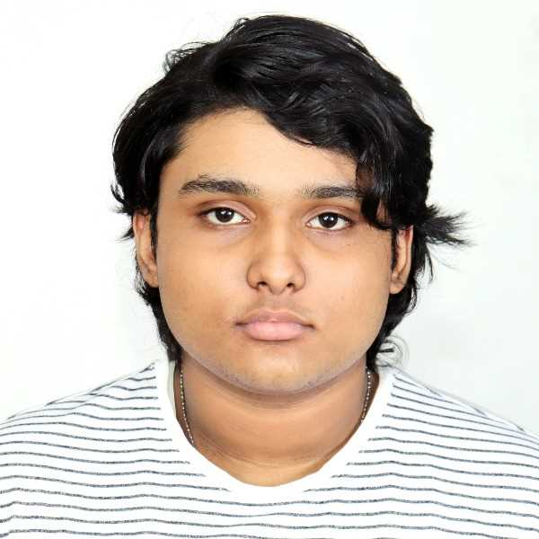

IT22054418|V.I.Kaluarachchi
Software engineering
IT22054418 | V.I.Kaluarachchi | 25-26J-458

Slide 9


Adaptive Scheduler: Adaptive Break Scheduling
Our core innovation addresses the critical gap in static study timers.
The Gap
Creative Solution
Personalized Cycles
Static timers fail to adapt to cognitive load; prior adaptive tools are often intrusive.
An Adaptive Scheduler using contextual bandit algorithms to dynamically balance study and break cycles.
Learns from real-time cognitive state, introducing new metrics (AHL, PG, BUC, SPF) for adaptive performance.
This bandit-based adaptive scheduling is novel in the education and productivity domain, moving beyond one-size-fits-all approaches and more intrusive approaches like EEG, cameras , etc. Simply Pomodoro → rigid ,EEG tools → intrusive + expensive
Adaptive LMS → focus on content, not schedule.
IT22054418 | V.I.Kaluarachchi | 25-26J-458

Slide 10






Specialized Knowledge & Technology
Domains Applied
Technologies Used
Fluid implementation
Fluid implementation using regression or decision trees.
Bandit Algorithms
HCI
Leveraging LinUCB and Thompson Sampling. Using bandit algorithms over deep learning RL due to ligher much faster online learning ability.
Adaptive timers and effective feedback design.
Data Science
Libraries
Reward modeling and personalization metrics.
Utilizing Scikit-learn and PyTorch.
Integration
React frontend with a robust Python backend.
IT22054418 | V.I.Kaluarachchi | 25-26J-458

Slide 11
Validation & Ethical Considerations
Evaluating Success
Data & Ethics
Metrics: Regret-per-hour, Personalization Gain, Break Utility Curve.
Data: Passive (keystroke timing, pauses) + micro self-reports.
Comparison: Against Pomodoro (fixed) and Random baselines.
Privacy: No text recorded, ensuring a privacy-preserving design.
Goal: Achieve ≥80% alignment with user's preferred cycle post-study.
Consent: User consent required; all data stored locally.
IT22054418 | V.I.Kaluarachchi | 25-26J-458

Slide 12




Adaptive Scheduler: Implementation in Action
Our system dynamically adjusts study and break intervals based on real-time user context.
Input Signals
Algorithm
Context from typing rhythm, pauses, and time of day.
Contextual bandit selects optimal work/break intervals.
Feedback
Update
Reward computed from post-break recovery and task progress.
Model adapts policies in real-time, continuously learning.
Imagine a student starting a session: the system recommends "30 min work + 5 min break." After the break, it checks recovery and adjusts the next cycle, learning a personalized schedule over time.
IT22054418 | V.I.Kaluarachchi | 25-26J-458

Slide 13
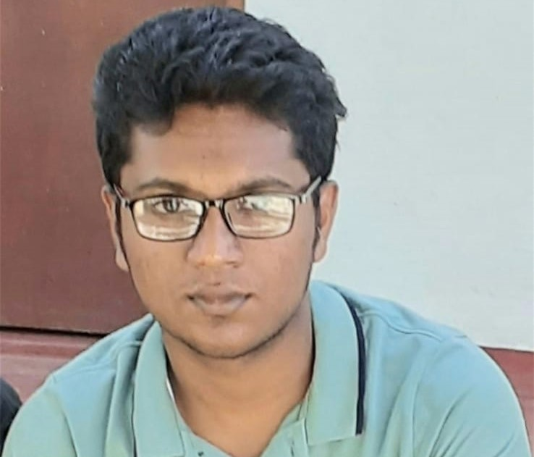
Yasasvin W.M.Y -- IT22276582
B.Sc. (Hons) Degree in Information Technology Specializing in software engineering
IT22276582 | Yasasvin W.M.Y | 25-26J-458

Slide 14
Research Problem & Novel Solution
Chronotype Heatmap & Insightful Recommendation
Unlocking a student's true learning potential requires more than just dedicated effort; it demands a personalized approach that aligns with their natural biological rhythms. Our solution directly addresses this fundamental challenge.
Knowledge Gap & Problem
Shortcomings of Existing Systems
Many students struggle to identify their most productive study times, leading to inefficient learning sessions.
Existing tools are often static, lacking personalized insights into individual behavior patterns.
Most study timers like pomdoro timers don't track crucial behavioral data like keystrokes or focus levels. They offer limited or non optimal study session recommendation, even cronotype based apps like Good Morning Sunshine app failing to provide truly tailored cronotype recommendations.
Proposed Solution: Adaptive Learning
We propose a hybrid system combining a chronotype heatmap — visualizing focus across the day — with contextual bandit model for dynamic, personalized session recommendations. study session suggestions and actionable insights.
IT22276582 – Yasasvin W.M.Y
IT22276582 | Yasasvin W.M.Y | 25-26J-458

Slide 15



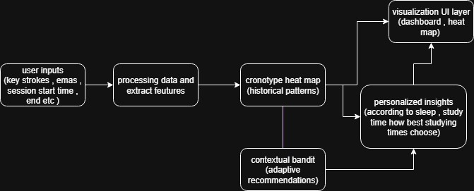
System Architecture & Technologies
Our system harnesses cutting-edge data science and behavioral psychology to create a truly responsive learning environment. It’s designed to understand, adapt, and optimize the individual learning journey.
Machine Learning
Human-Computer Interaction
Data Analytics & Visualization
Leveraging Contextual Bandit algorithms to provide optimal study session recommendations based on user interaction and performance.
Integrating behavioral tracking (keystrokes, session lengths) and micro-EMA inputs for nuanced understanding of user state and focus levels.
Generating intuitive chronotype heatmaps and detailed session analyses to visualize productivity patterns and inform recommendations.
Key Technologies Utilized
Validation & Success Metrics
Contextual Bandit Model: For recommendation and insight engine
Accuracy: Precisely predicting optimal session cronotypes
Chronotype Heatmap Visualization: To clearly display individual productivity cycles.
Productivity Gains: Quantifiable improvement in focus metrics.
User Engagement: High satisfaction, retention, and consistent usage.
Data & Ethics
We ensure robust data privacy, with all user activity data (keystrokes, session timing) collected under strict ethical guidelines and anonymization protocols.
IT22276582 – Yasasvin W.M.Y
IT22276582 | Yasasvin W.M.Y | 25-26J-458

Slide 16



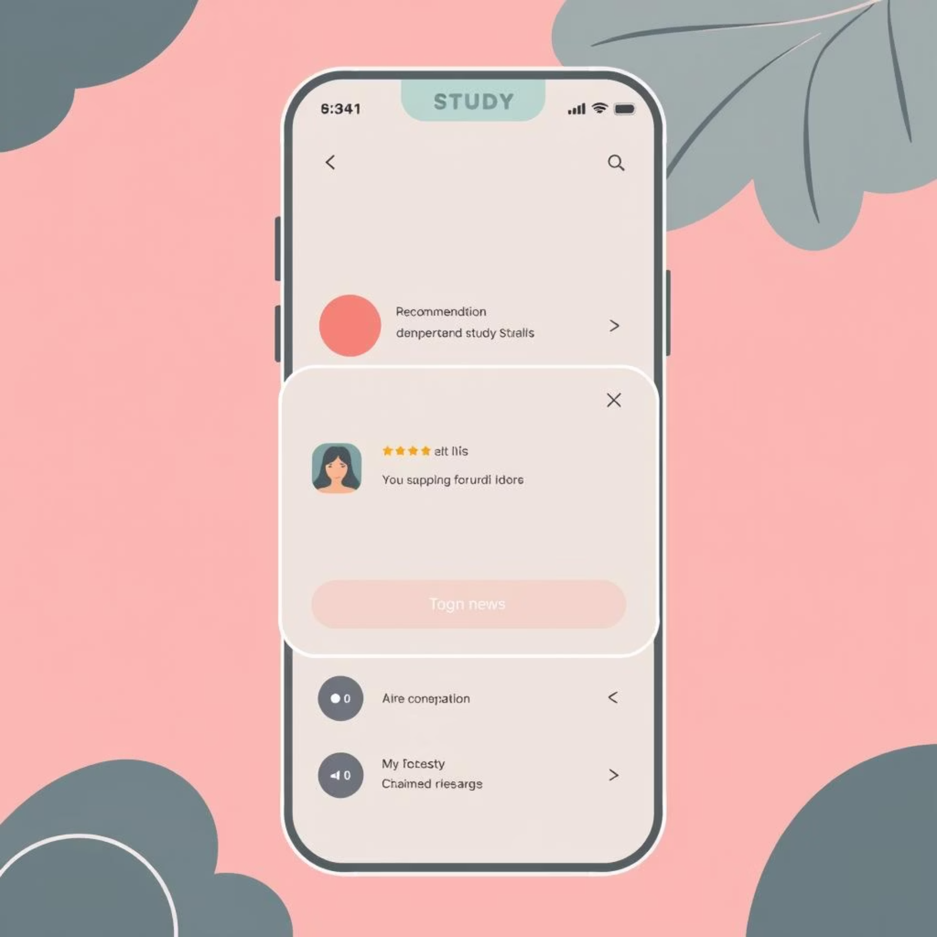
System Overview & Real-World Usage
This integrated system empowers students to optimize their learning by aligning study habits with their unique biological rhythms, translating complex data into actionable insights for everyday use.
Data Collection
Heatmap Generation and ml model process
ML Recommendation
Collects keystrokes, session timings, and micro-EMA feedback during study.
Generates a chronotype heatmap visualizing individual focus patterns over time.
Contextual Bandit model recommends optimal study sessions.
Transforming Study Habits
Students simply open the app and log their study sessions. The system then provides dynamic recommendations based on their prior behavior and real-time input. This leads to profound changes in learning efficiency.
Insight: "Your best 50-minute focused session today was from 4:00 PM - 4:50 PM. Consider that time tomorrow!"
Warning: "Avoid studying after 10:00 PM, your focus consistently dips during this period."
Seamless Integration for Enhanced Learning
IT22276582 – Yasasvin W.M.Y
IT22276582 | Yasasvin W.M.Y | 25-26J-458

Slide 17



Smart Study Scheduler: Commercialization & Growth
This AI-driven solution offers significant market potential, providing personalized learning benefits across diverse educational sectors and fostering academic success.
Market Opportunities & Value
Our unique, adaptive scheduling can transform productivity for students and institutions. It's a lightweight tool, delivering measurable academic improvements by aligning study times with peak cognitive states.
Target: Students
Enhancing individual academic performance and well-being.
Target: Institutions
Bulk licensing for improved student retention and success rates.
IT22276582 | Yasasvin W.M.Y | 25-26J-458

Slide 18
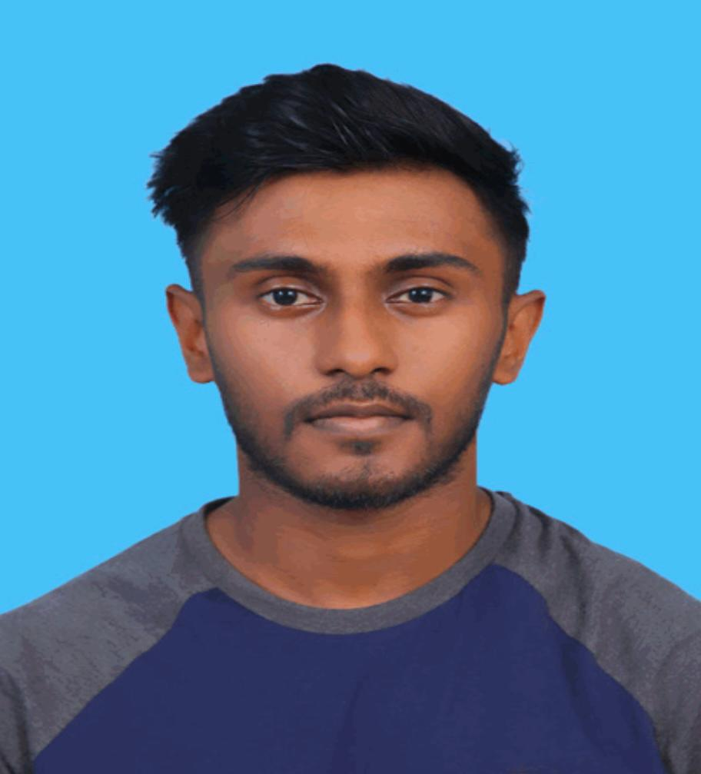
RAJENDRAM P.A. -- IT22087874
B.Sc. (Hons) Degree in Information Technology Specializing in software engineering
IT22087874 | RAJENDRAM P.A. | 25-26J-458

Slide 19
Proven Gap / Creative Solution
The Problem: Flawed Focus Apps
Our Solution: Intent-Lock Overlay
Existing focus apps are either too rigid or too permissive. Users disengage impulsively due to boredom or habit, lacking reflection mechanisms.
Graduated Friction
Adaptive nudges prevent impulsive exits.
Rigid blockers cause frustration.
Predictive Model
Permissive timers fail to prevent.
Classifies exits to tailor interventions.
No personalization or reflection.
Reflection Logging
Builds distraction profiles for mindful habits.

Slide 20



Specialized Knowledge Application (Part 1)
Key Domains Utilized
HCI
Machine Learning
Behavioral Psychology
Designing friction nudges and reflection prompts for user engagement.
Predictive exit classification using contextual features.
Interventions to reduce impulsive task-switching.
Latest Technologies in Use
Lightweight ML models (Logistic Regression, Decision Trees).
Front-end overlay frameworks for study apps.
Open-source libraries: scikit-learn, TensorFlow Lite, PyTorch.

Slide 21
Specialized Knowledge Application (Part 2)
Evaluating Success
Data & Ethical Clearance
Metrics
Data Sources
Impulsive-exit reduction %, bypass latency, user satisfaction scores.
User interaction logs (typing pace, app-switch frequency).
Reflection Prompts
Validation
Provide self-reported disengagement reasons.
Pilot studies with students; usability testing for acceptance.
Ethical Safeguards
Accuracy
On-device storage, user consent, transparency.
Predictive model target: >70% accuracy in classifying exits.

Slide 22
References
IEEE Referencing Format
[1] Zerbini, G., et al. (2017). "Time to learn: How chronotype impacts education." PsyCh Journal, 6(4), 263-276. Available at:
[2] Goldstein, D., et al. (2023). "Chronotype, Time of Day, and Performance on Intelligence Tests in the School Setting." Behavioral Sciences,
[3] Nguyen, T. M., et al. (2023). "A Review on Smartphone Keystroke Dynamics as a Digital Biomarker..." Brain Sciences.
[4] Vollmer, C., et al. (2023). "A better alignment between chronotype and school timing I
s associated with lower grade retention in adolescents." npj Science of Learning, 10, 25.
[5] Goldin, A. P., et al. (2017). "Lower school performance in late chronotypes: underlying factors and mechanisms." Scientific Reports, 7, 4385:
[6] Chen, Y., et al. (2023). "Adaptive Sequence Learning: Contextual Multi-armed Bandit Approach." IEEE International Conference on Data Mining.
[7] Lan, A., et al. (2016). "A Contextual Bandits Framework for Personalized Learning Action Selection." Educational Data Mining. Available at:
[8] Hunziker, A., et al. (2020). "Reinforcement Learning for the Adaptive Scheduling of Educational Activities." Proceedings of the 2020 CHI Conference on Human Factors in Computing Systems.
IT22276582 – Yasasvin W.M.Y
IT22276582 | Yasasvin W.M.Y | 25-26J-458

Slide 23
[9] Multi-Armed Bandits for Intelligent Tutoring Systems. Journal of Educational Data Mining (2015). Available at:
[10] Expert Features for a Student Support Recommendation Contextual Bandit Algorithm (2024). Proceedings of the 14th Learning Analytics and Knowledge Conference.
[11] An Overview of Contextual Bandits (2025). Towards Data Science
[12] Dynamic Linear Epsilon-Greedy: A Bandit You Can Trust (2023). Proceedings of the 31st ACM Conference on User Modeling, Adaptation and Personalization.
[13] Contextual Bandits as Supervised Learning (2024). True Theta
IT22276582 | Yasasvin W.M.Y | 25-26J-458

Slide 24








Adaptive Cognitive-Load Study Timer
Commercialization & Impact
Cost & Recovery
Target Market
Low development cost, subscription/licensing model, recover within 6 months.
Students, self-learners, and professionals; integrate with LMS platforms.
Intellectual Property
Value Proposition
Patentable scheduling metrics and fusion of micro-EMA with bandits. Potential SDK integration.
First privacy-preserving, adaptive AI timer. Enhances focus efficiency and prevents burnout.
1M+ students use Pomodoro apps; capturing even 1% market (~10k users) at $2/month yields $20k monthly revenue.

